Slide 1


Consumer market entry readiness engagement
Requirements Gathering Project Process Maps

Slide 2

Process Mapping – Commonly Used UML Symbols
Decision Point
Data
Start and End Process
Process Step
Manual Operation
Decision Point
Process Step
Yes
Manual Operation
Symbols are connected to show flow, like this:
No
Process Step

Slide 3
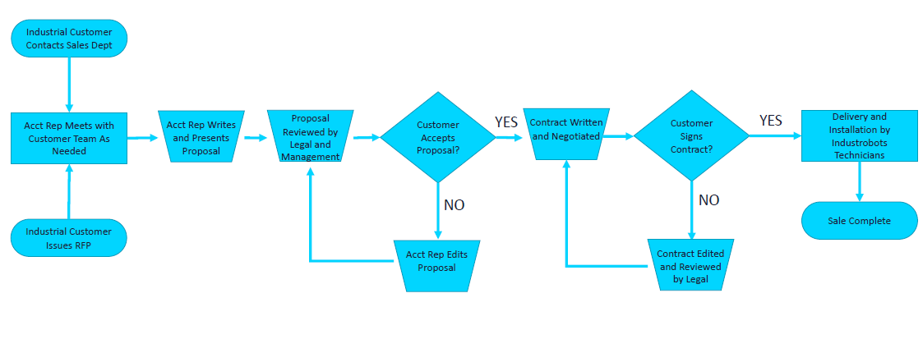
“As-Is” Process Map
Industrobots Existing Sales Process

Slide 4
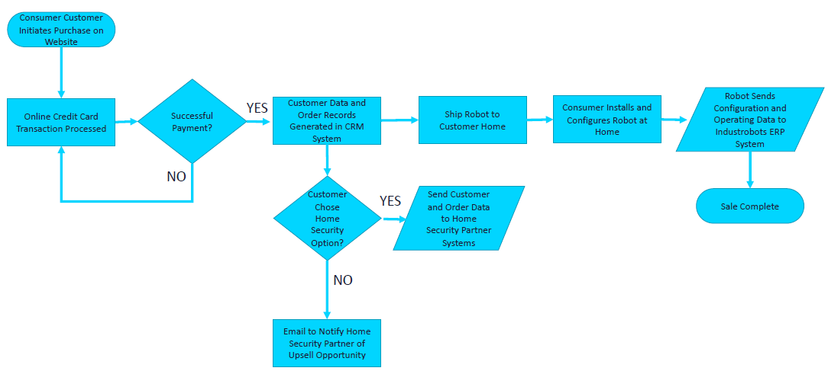
“To-Be” Process Map
Industrobots Future Sales Process

